Slide 1
Planning Quantum Stack les 3
Minor Quantum Computing
Ed Kuijpers, e.a.kuijpers@hva.nl
17-5-2024

Slide 2
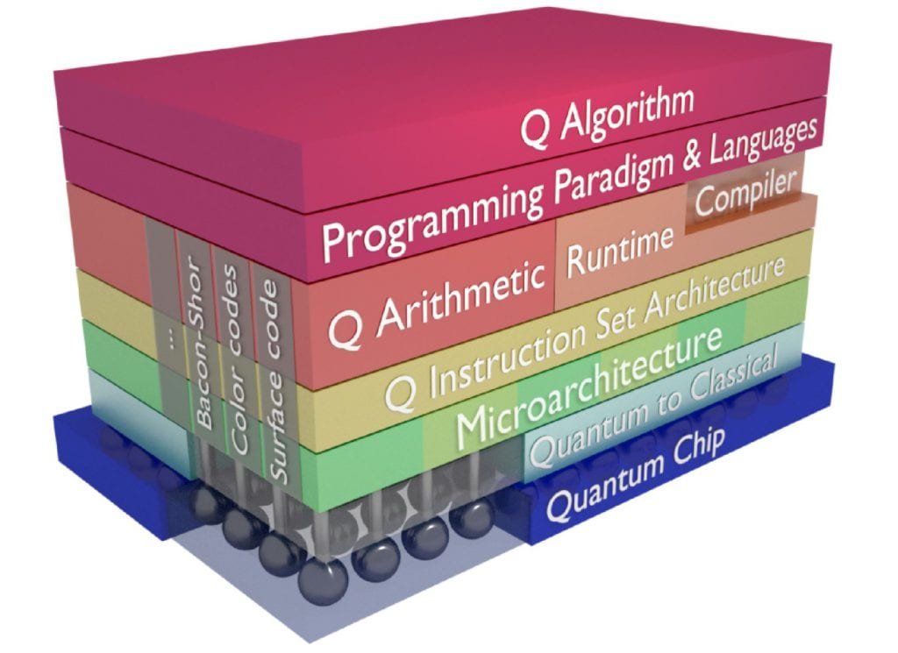
Topics
Structure lessons
Writing paper and presentation in phases
Structure quantum stack
Discussion topics for paper

Slide 3
Quantum Stack
Abstraction layers
Stack models

Slide 4
Structure lessons
Each lesson presentation wil focus on a layer in Quantum Stack
Students individually select Quantum stack topic for writing paper
Students select, motivate and present a topic
Students present draft paper/progress
Finalize paper with final presentation

Slide 5
Draft schedule update
Lesson 1: (19 April): introduction topics
Lesson 2: (26 April)Quantum computing Languages + student paper proposals
Lesson 3: (17 May) Hardware and background + student paper proposals
Lesson 4: (24 May) Quantum hardware + student proposals
Lesson 5 (31 May): Quantum internet + progress reporting paper students
Lesson 6 (7 June):Quantum Information, sensing and learning + progress reporting paper
Lesson 7 (14 June): Quantum stack progress reporting
Lesson 8 (18 June): Paper presentation
Week B5 (Aug): Resit Presentation

Slide 6
Approach
Assignment-1proposed content paper
Title
Research questions
Motivation
Literature reference(s)
Assignment-2 intermediate results
Draft paper material
Presentation intermediate results
Intermediate feedback via paper and presentations
Assignment-3 upload final paper
Final presentation
Grading

Slide 7
Background
Previous experience for the Software for Science minor (before Quantum Computing)
Number of pages (in English): effort in accordance with Credits (3 ECTS) and quality (7 – 12 pages) including some good figures
https://studiegids.hva.nl/co/hbo-ict-vt/100000042/100888)
In assessment: mix of software experiments with documentation appreciated
Scientific format paper (LaTeX), backup pdf after MSWord conversion
Diversity in topics to avoid too much overlap, interesting,
Avoid grading work twice, i.e. team project result assessment and paper assessment not overlapping
Topics lessons will be adapted to research questions as far as possible (lesson will not limited to one layer)
New Qubit material (Graphene, gold based, superconduction at higher temperatures)

Slide 8
Paper proposals presented en in DLO
Optical computing (Daniel)
Advanced Quantum error correction (recent developments at Microsoft and IBM)(luca)
OpenQL (Gaurav)
Theoretical design of a QPU(Lilith)
ML en quantum stack for real life cases(Thomas)
OpenQasm(Tijs)

Slide 9
To be presented (draft)
Quantum Processor network for variational quantum eigensolver(Siar)
Qubit interaction and physics/electronics? (Ilnur)
Quantum error correctioin/sensing? (Benjamin)
The Hybrid Computer: A Classical and Quantum Stack Combined(Qiing)
Quantum memory ?

Slide 10
Discussion of paper topics
Who is missing idea for topic?
What information you need?
References ?

